Slide 1


Slide 2


Slide 3


Slide 4


Slide 5
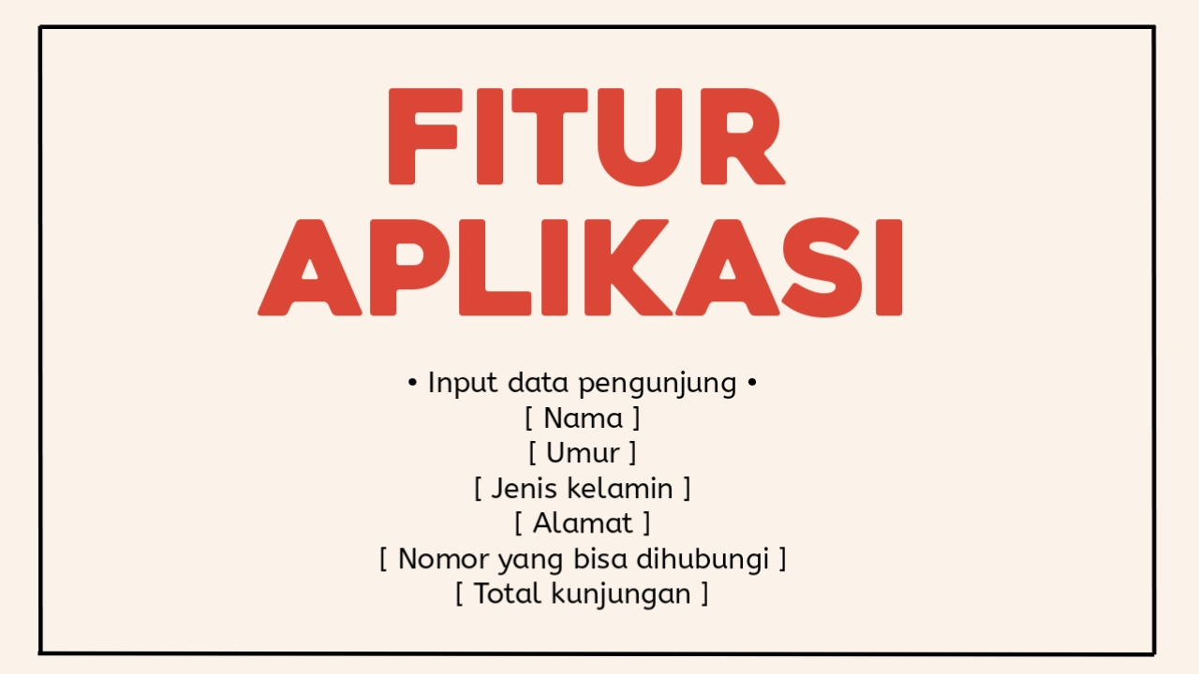

Slide 6
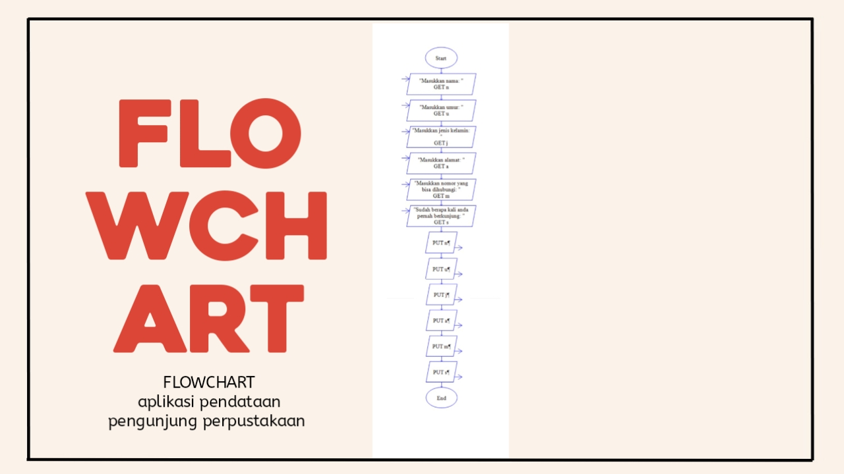

Slide 7
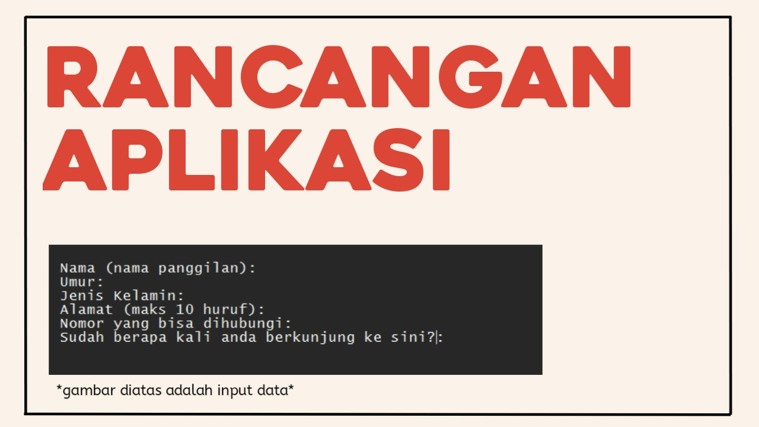

Slide 8
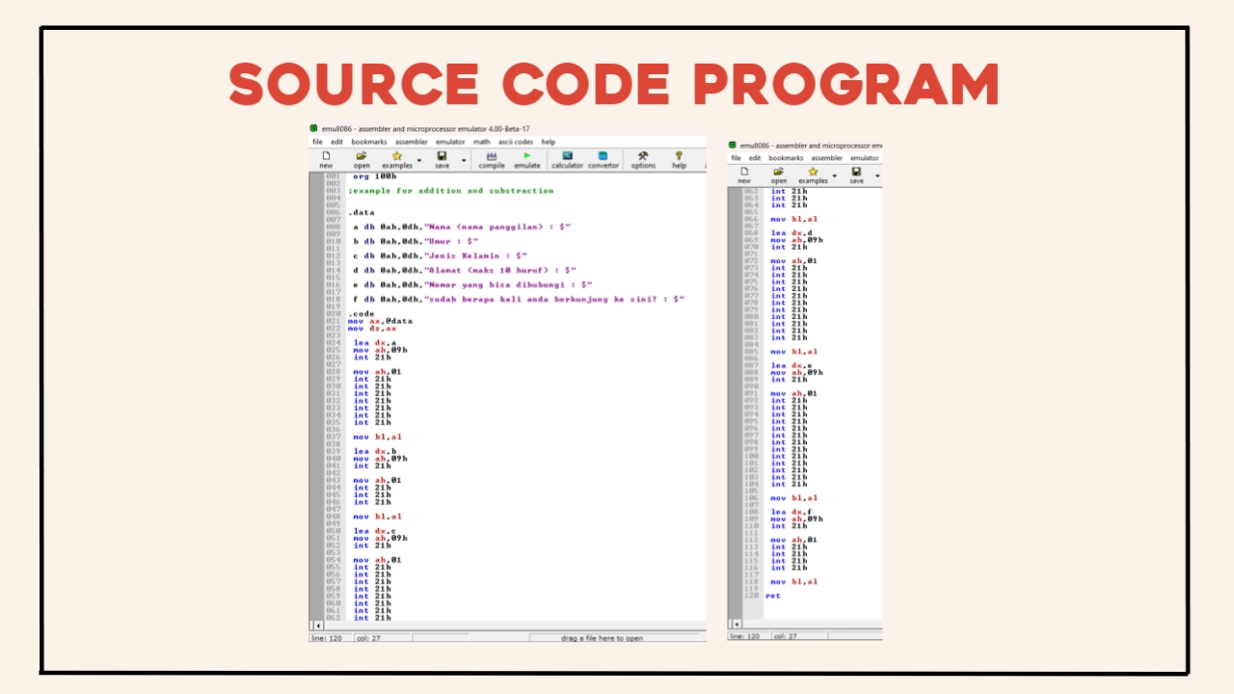

Slide 9
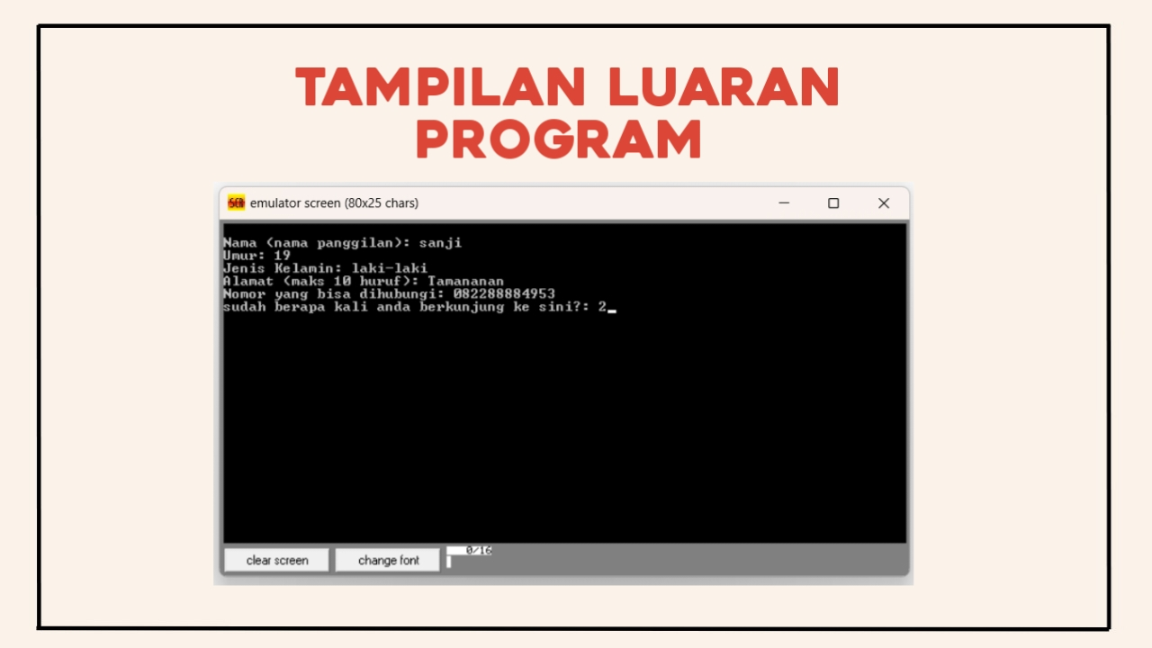

Slide 10
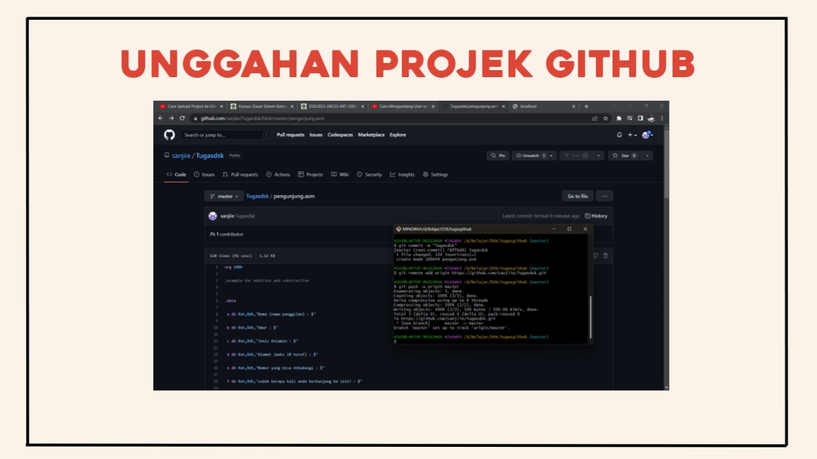
https://github.com/sanjiie/Tugasdsk/blob/master/pengunjung.asm

Slide 11


